Slide 1
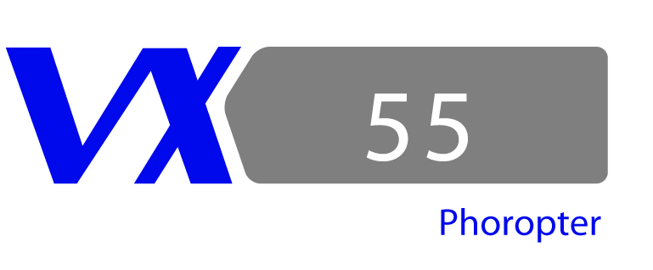
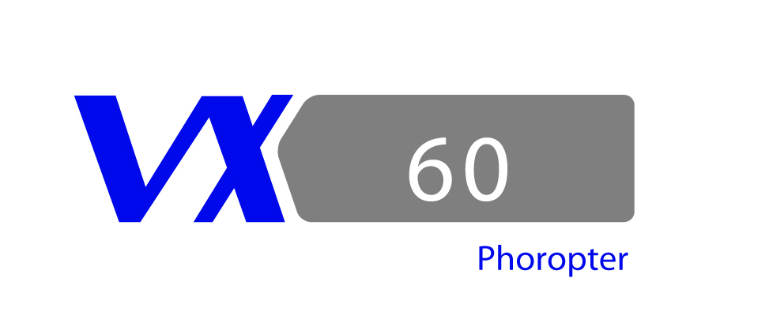
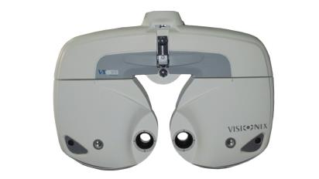
Visionix

Slide 2
Another way of working
Intuitive Full automated soft
Manual phoropter flow PC or control panel
Remote acces

Slide 3
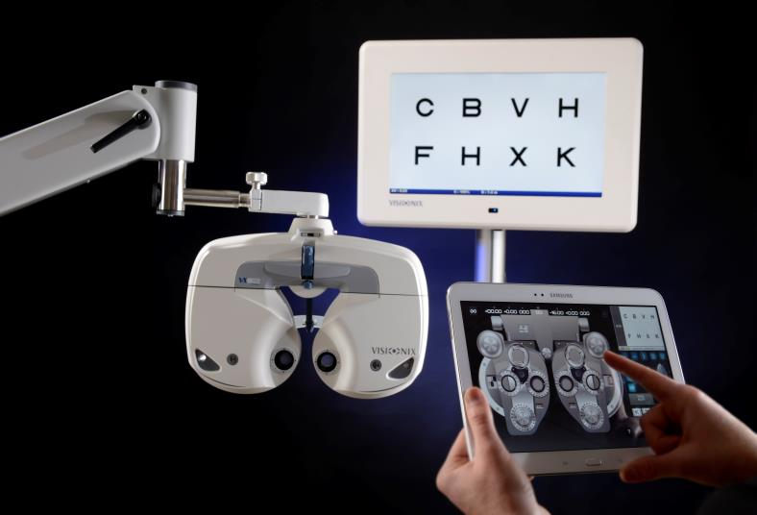

Slide 4
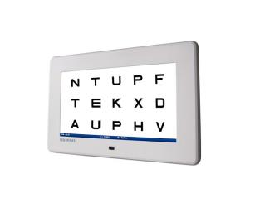
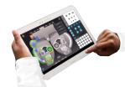




L40P 24 inch or L40 19 inch
Comprehensive range of application from low vision to hyper acuity
Contrast and colour tests.
Aesthetic and compact design.
Highly luminous screen with strong contrasting ability
Working distance 2m to 6m (6.6 ft to 19.7 ft)
Intuitive remote control
Easy to upgrade.
Multimedia function.
Polarized 24’’ screen.
VX55
Fully motorised
Wireless communication
Quiet
Wide visual field
Independent pupillary adjustment
LED lighting for near vision
-19 to +16.75D
Min step sphere : 0,25, Integrated prisms
Tablet android also acts as chart display remote control
Very intuitive, small step from a manual phoropter
No need to stand close to the patient
Easy to switch from manual head
Teamviewer possibilities for remote access
Tablet

Slide 5
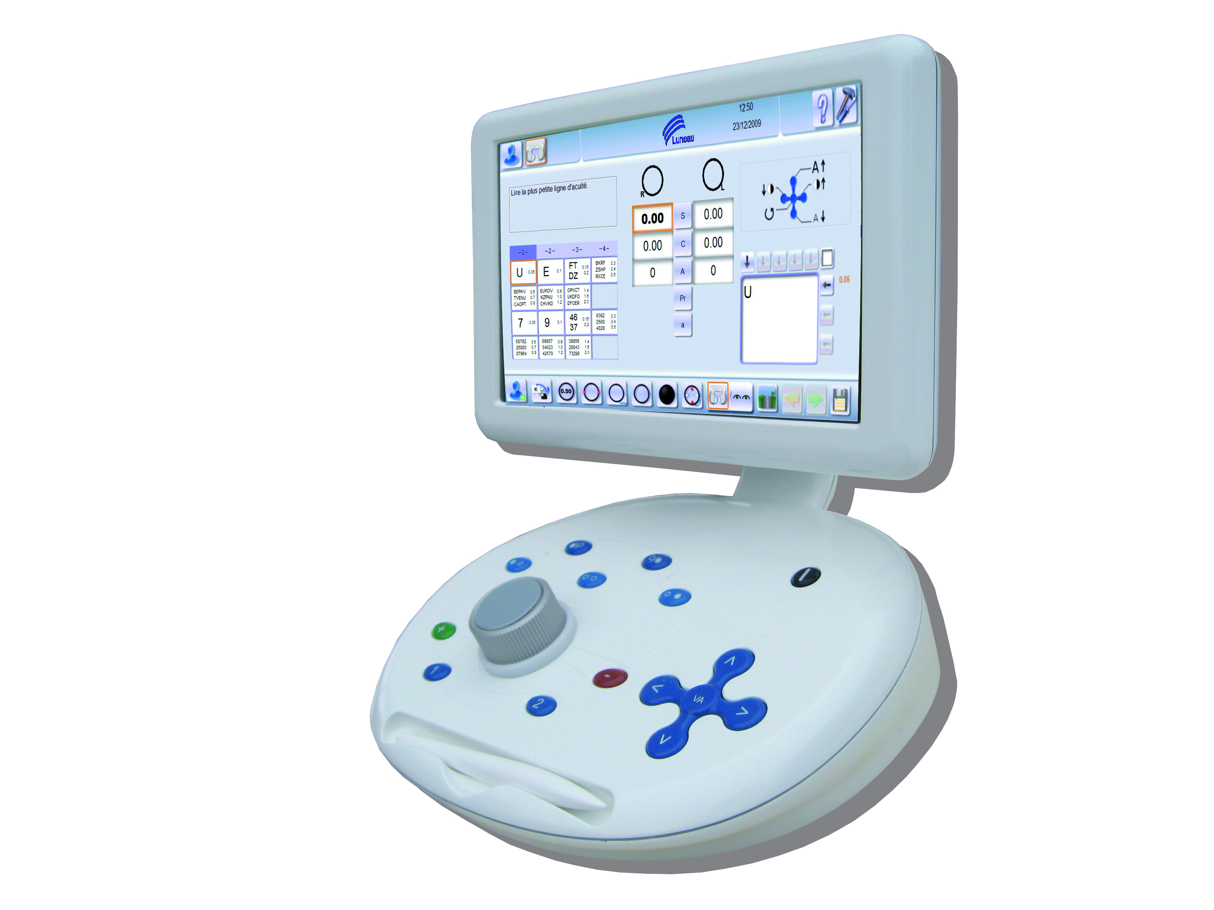
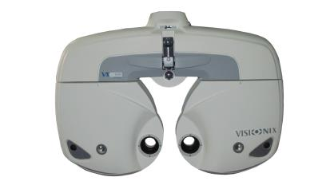
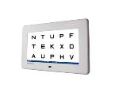
Different software version and control
Controlpanel
Fully automated software
Direct functionnal access
Teamviewer possibilities for remote access
Very stable environment
Touchscreen
Acts as remote control LCD

